Slide 1
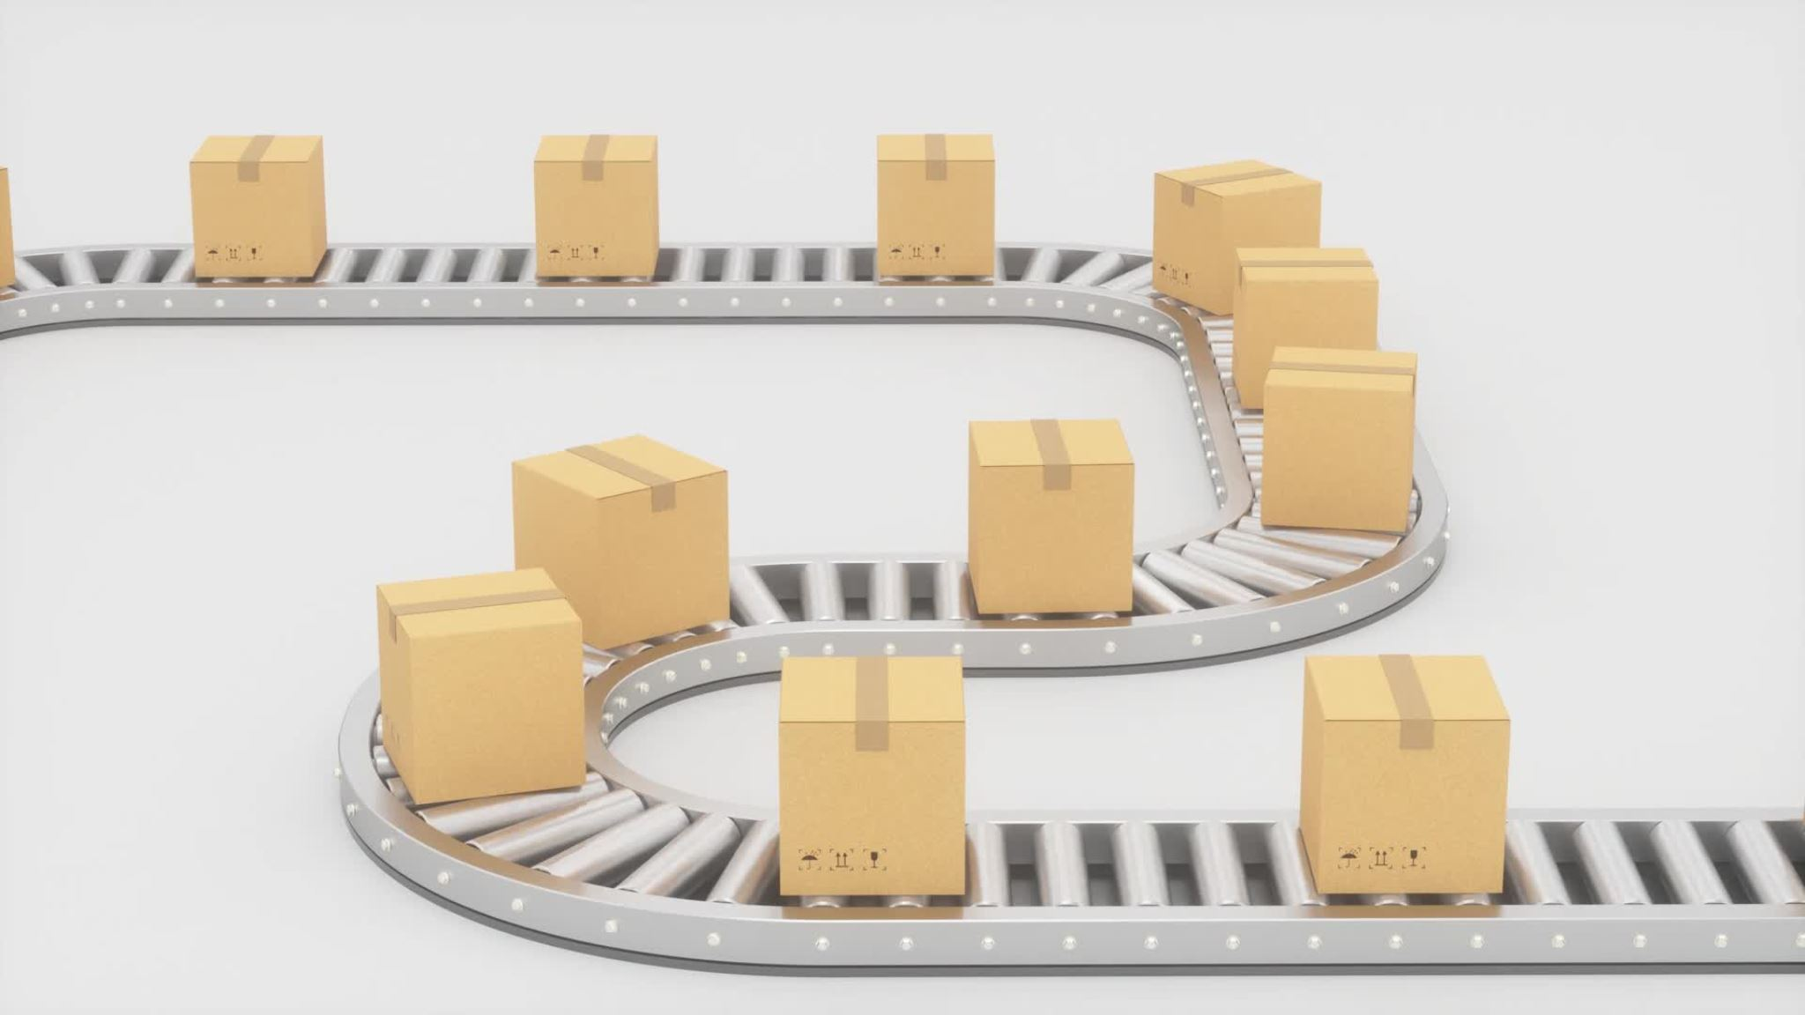
Modeling Battery Restoration
Randy Koliha, Isaiah Sarria, Jack Levitt , and Susan Nunez

Slide 2
Introduction
The AnyLogic model represents costs associated with a reverse logistics process that involves two parts.
First: collecting, storing, and transporting defective Electrical Vehicle Batteries.
Second: the recycling and remanufacturing of those defective Electrical Vehicle Batteries to convert them into a completely restored Electrical Vehicle Battery.
Using an optimization and efficiency factors of both of those parts, we want to see how these costs are impacted.

Slide 3
What is a dynamic variable?
Values that are constantly re-evaluated according to the equations you define for them.
In our case the dynamic variable holds its cost divided by the parameter rates.
Our dynamic variables: Collection Cost, Transportation Cost, Storage Cost, Total Cost of Electric Battery Recover, Recycling Cost, Remanufacturing Price, Recycling Fee

Slide 4
What is a parameter?
A parameter is normally a constant in a single simulation and is changed only when you need to adjust your model behavior.
In our case we defined the parameter as a rate of time per minute.
Our parameters with adjustable sliders are: Optimized Logistics and Efficiency of Recovery Process.

Slide 5
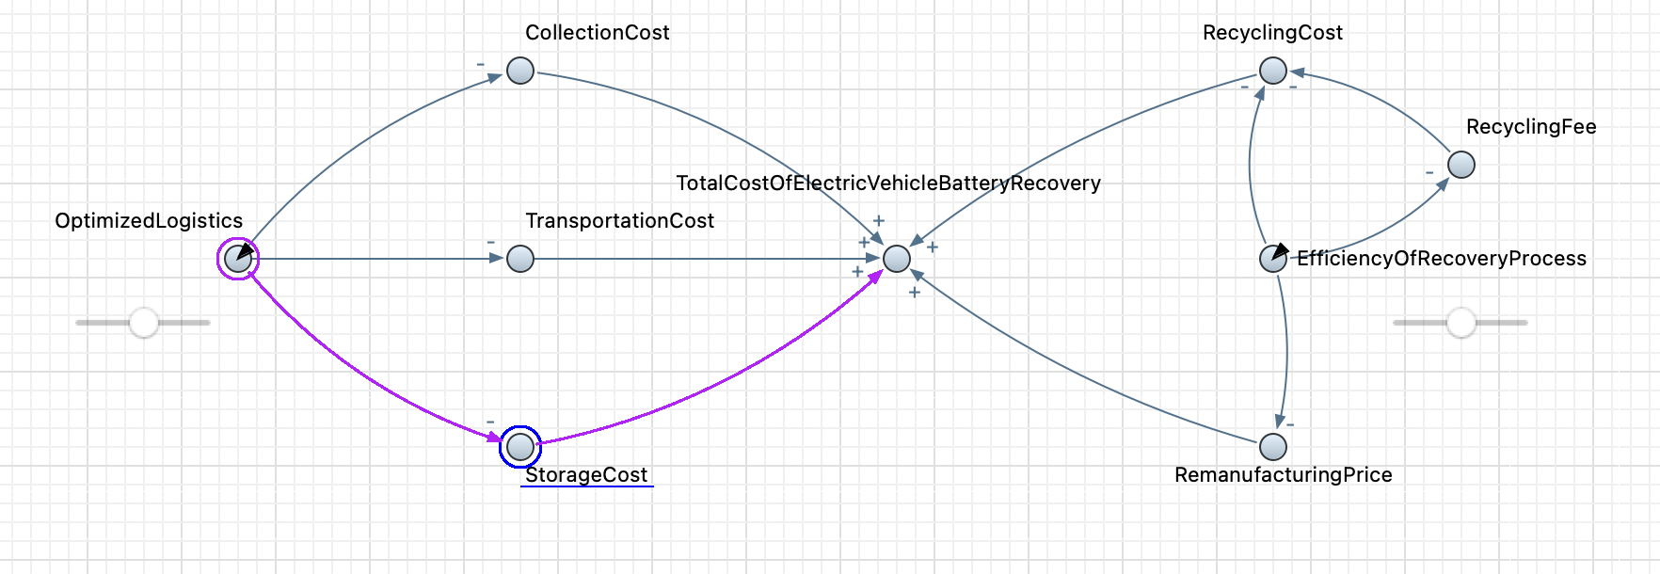
Model Overview

Slide 6
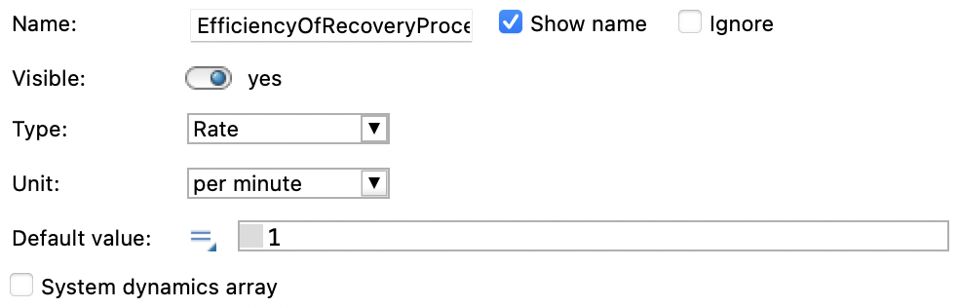
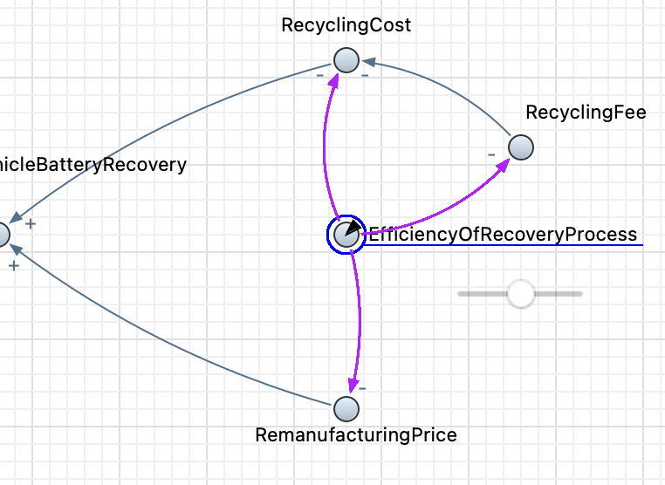
Parameters

Slide 7
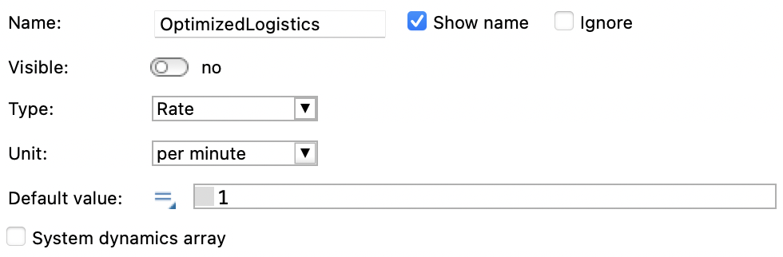
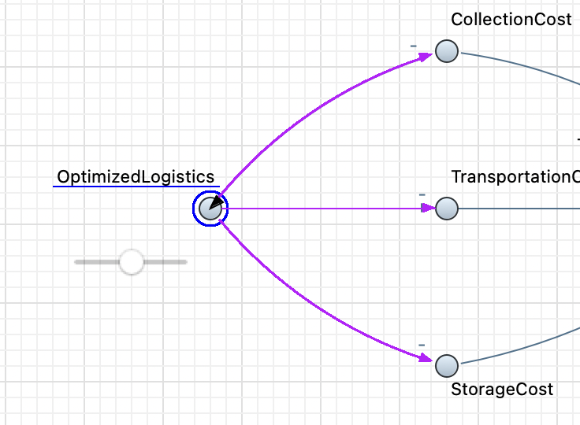
Parameters

Slide 8
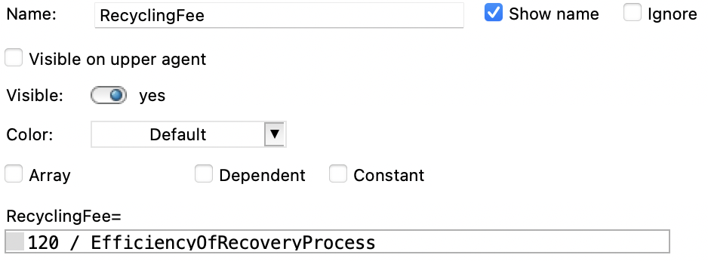
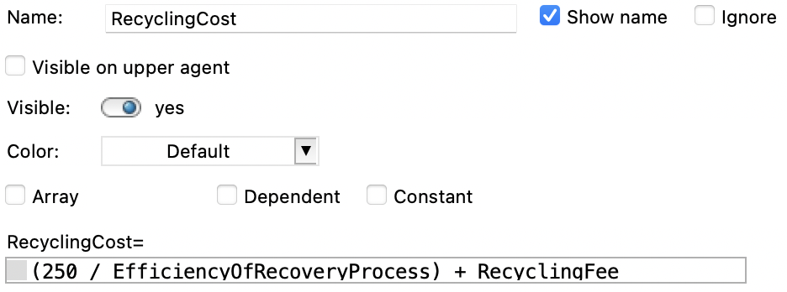
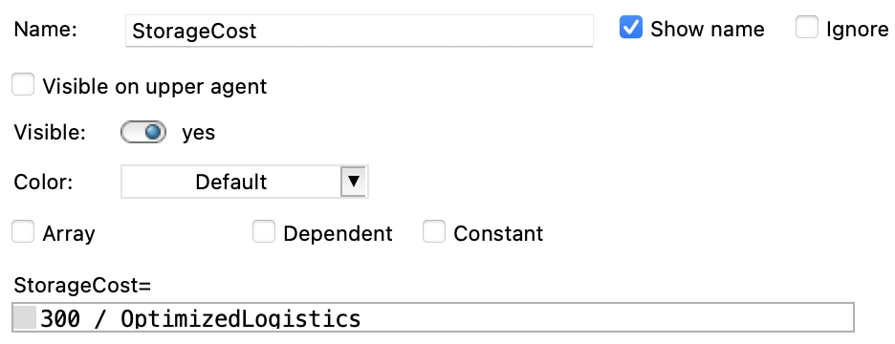
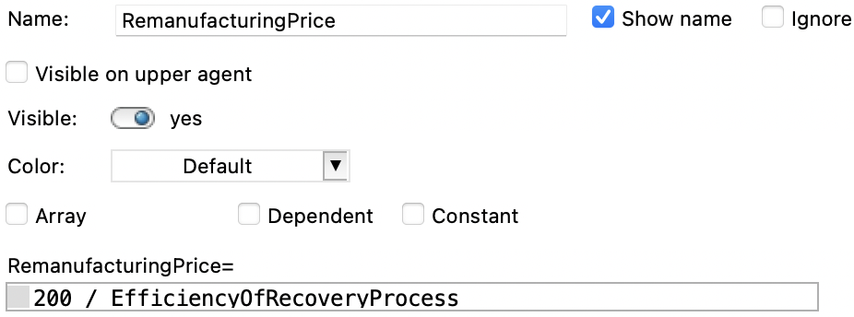
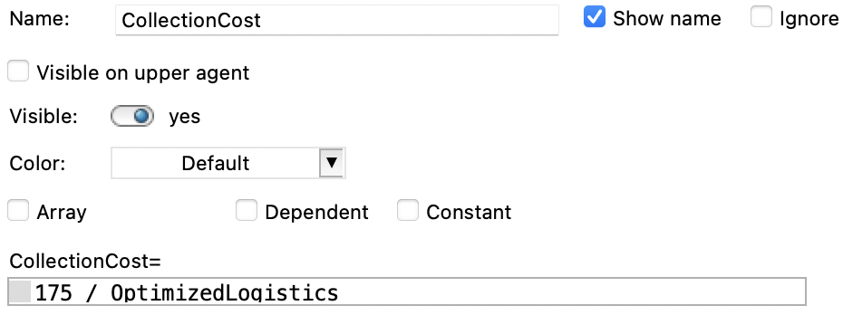
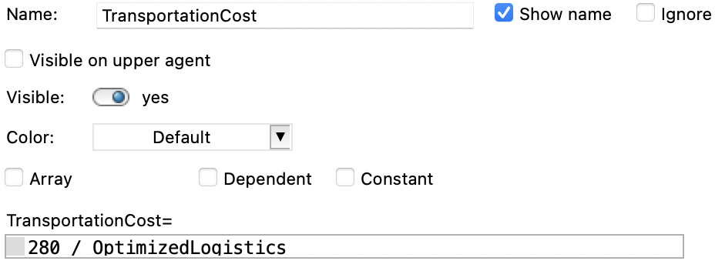
Dynamic Variables

Slide 9
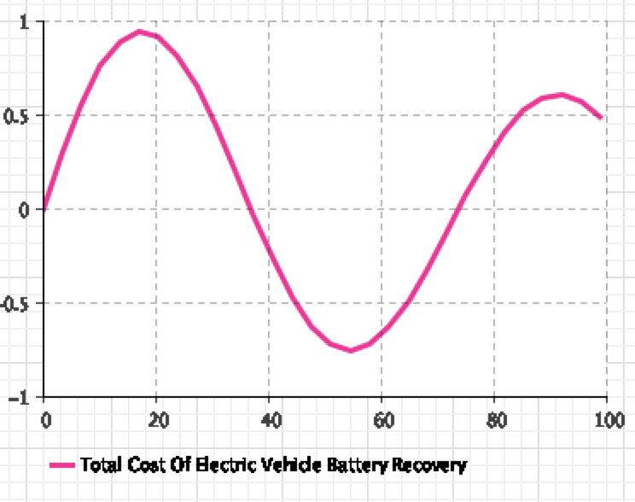
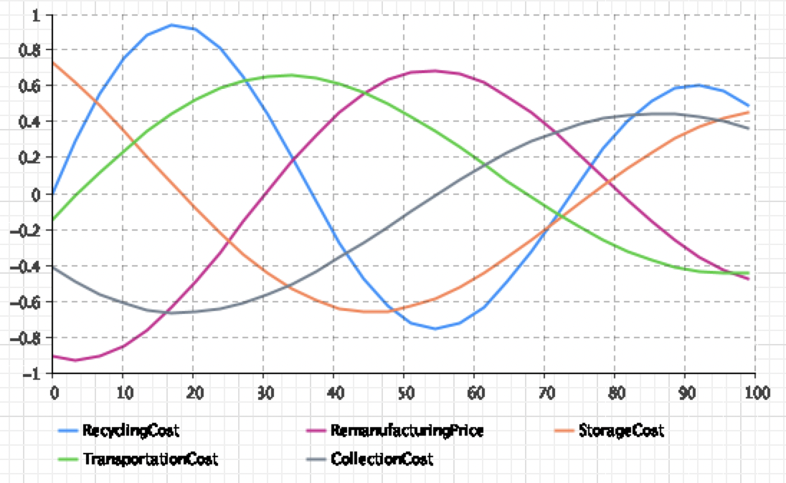
Graphs

Slide 10
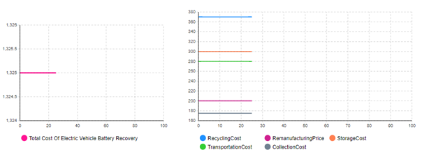
Results
These graphs state this is when the sliders are both at 1 meaning making it at its max efficiency. Bringing all the costs and total costs to the lowest level as possible.

Slide 11
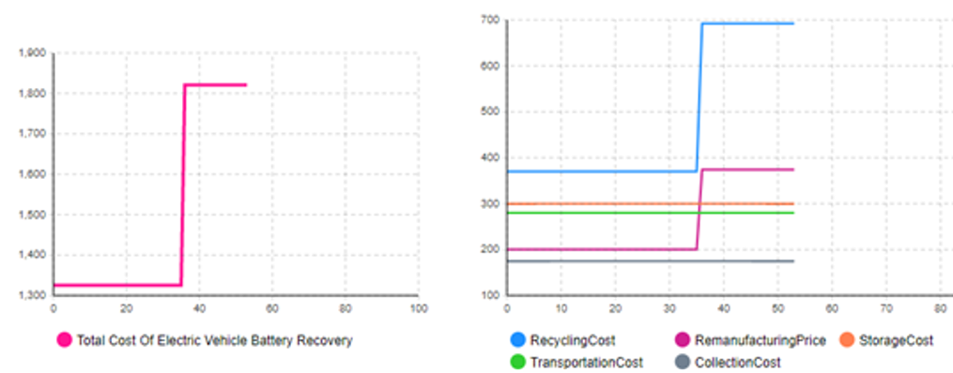
Results
These graphs show when the slider on the right is reduced, efficiency drops making costs increase for efficiency of recovery processes respective costs. This also bring the total cost up but only by the aggregated costs on the right. When the slider is back on 1 the cost drops.

Slide 12
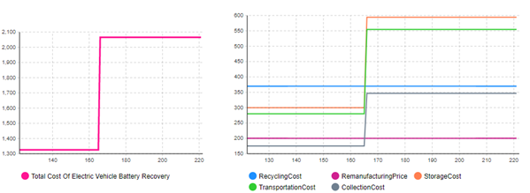
Results
When the slider on the left is reduced, efficiency has dropped causing the costs to increase for optimized logistics respective costs. This also brings the total cost up but only by the aggregated costs. When the slider is back on 1 the cost drops.

Slide 13
Conclusion
All of the costs in the model contribute to the total costs of restoring electric car batteries.
The optimization of the logistics process and the efficiency of the recovery process both reduce the total cost.
The graphs show how they independently affect the costs.

Slide 14

Questions?

